Slide 1

KL Divergence

Slide 2
Reference
Youtube on Integration Tricks involving Normal Distribution
Youtube on Jensen’s Inequality
Youtube
Code

Slide 3
KL Divergence

Slide 4
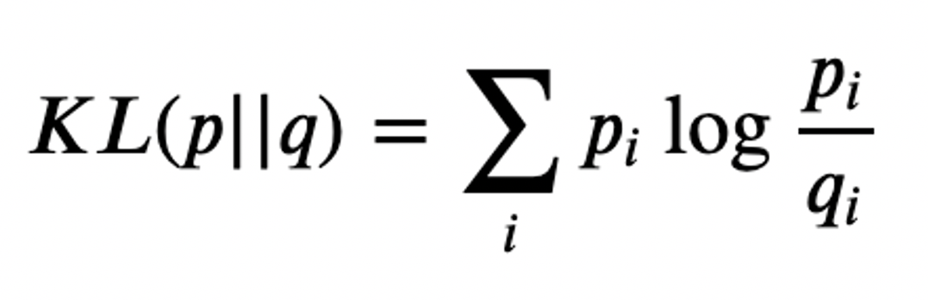

Slide 5
KL Divergence is not
Distance Metric

Slide 6
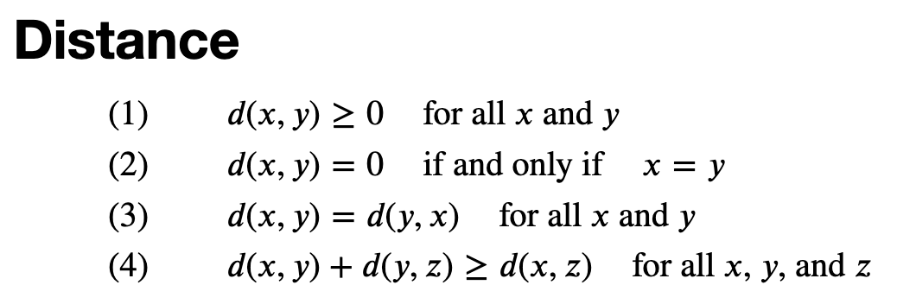

Slide 7

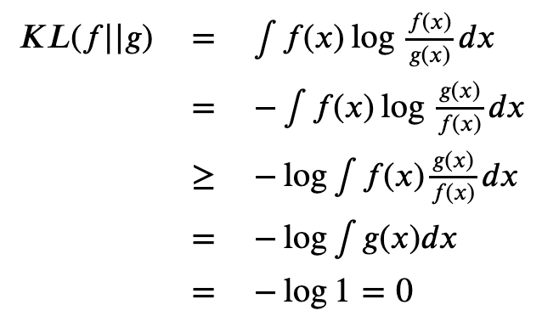

Slide 13
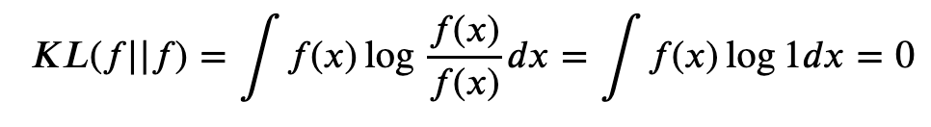

Slide 17
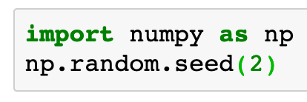

Slide 18
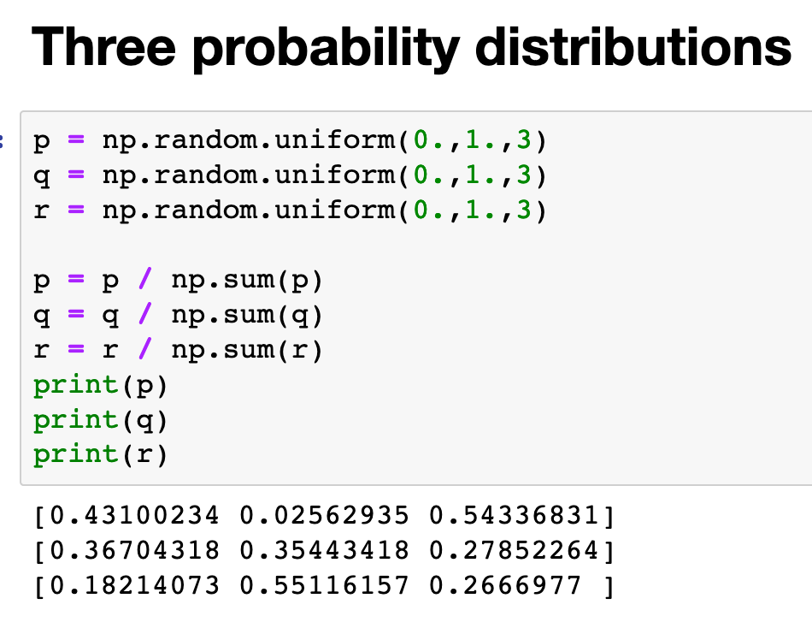


Slide 19
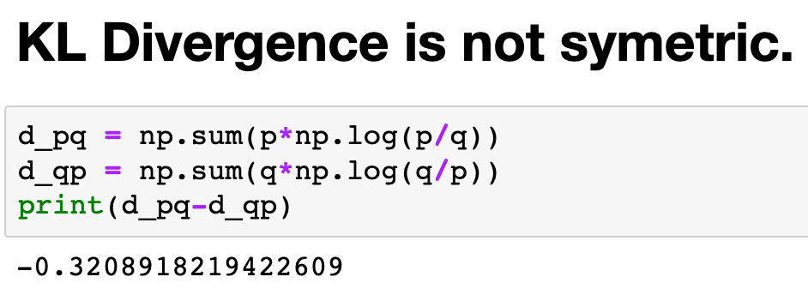

Slide 20
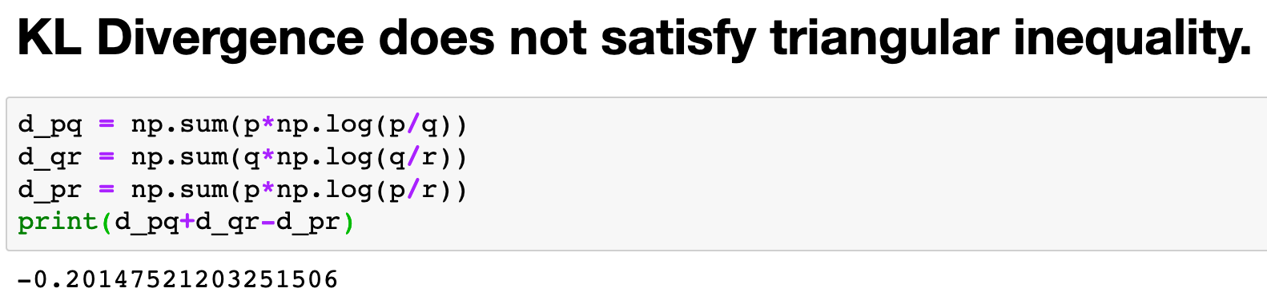

Slide 21
But,
KL Divergence is approximately
Distance Metric
locally

Slide 22
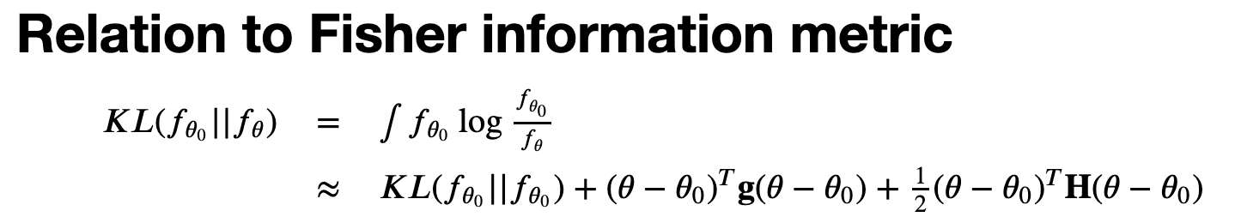

Slide 25

0-th order term is zero

Slide 26
0-th order term is zero

Slide 27
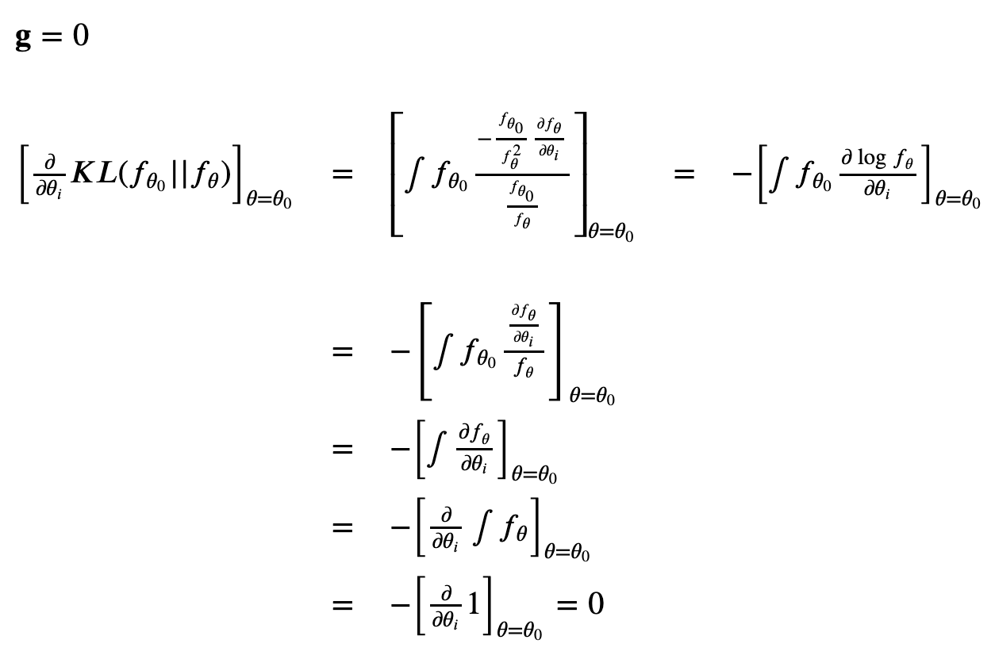
1st order term is also zero

Slide 28
1st order term is also zero

Slide 29
1st order term is also zero

Slide 30
1st order term is also zero

Slide 31
1st order term is also zero

Slide 32
1st order term is also zero

Slide 33
1st order term is also zero

Slide 34
1st order term is also zero

Slide 35
1st order term is also zero

Slide 36
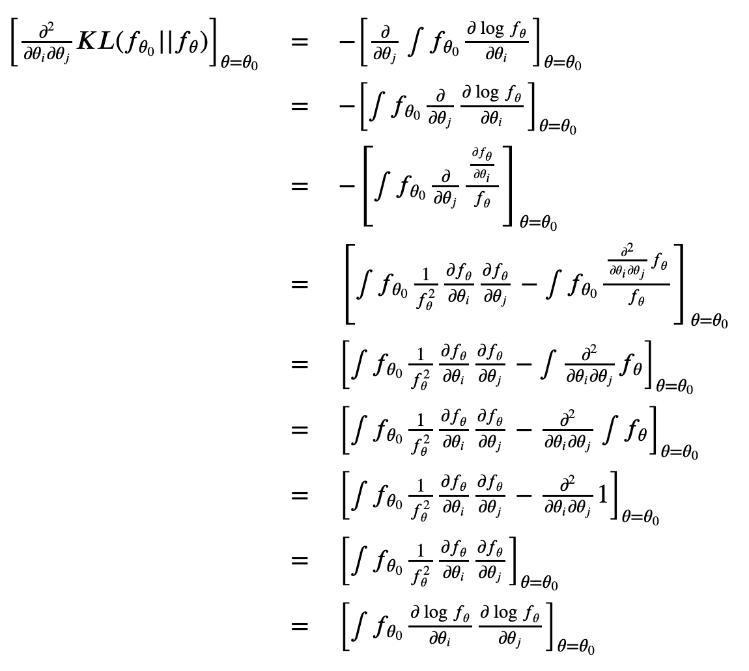

Slide 46
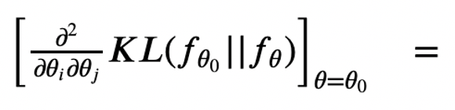
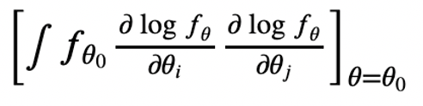
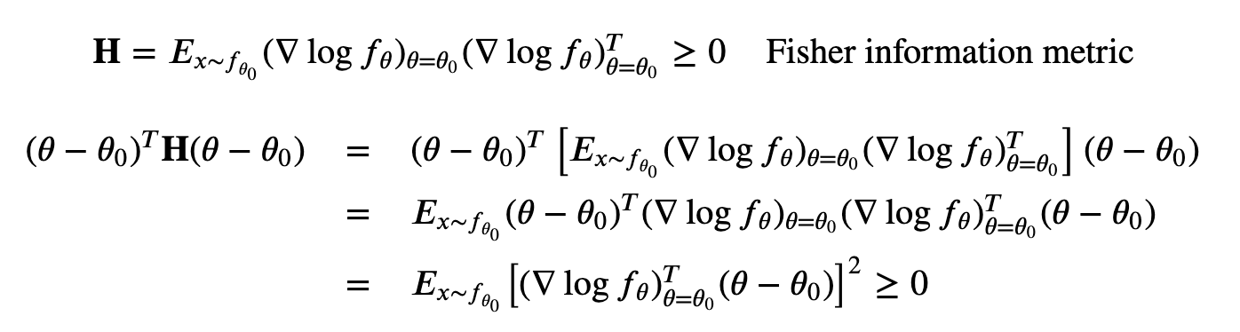
2ne order term is positive

Slide 47
2ne order term is positive

Slide 48
2ne order term is positive

Slide 49
2ne order term is positive

Slide 50
2ne order term is positive

Slide 51
KL Divergence between Two Normals

Slide 52
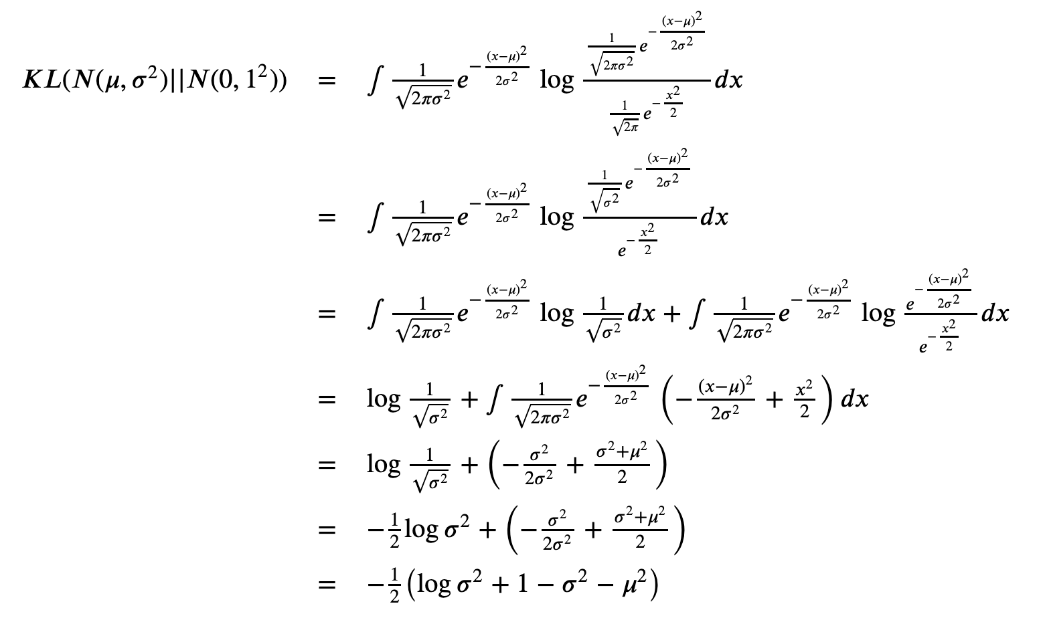

Slide 60
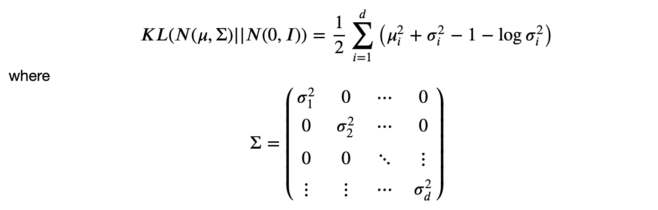


Slide 61
Now
Let’s Play with Code

